Slide 1


Town Of Yountville
Quarterly report April may June 2022
Prepared By Engineer Kyle Black

Slide 2
Town Of Yountville
Quarterly Report 2nd Quarter 2021

Slide 5


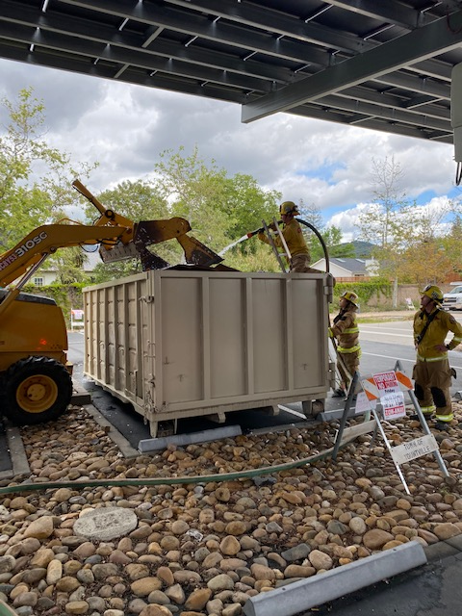

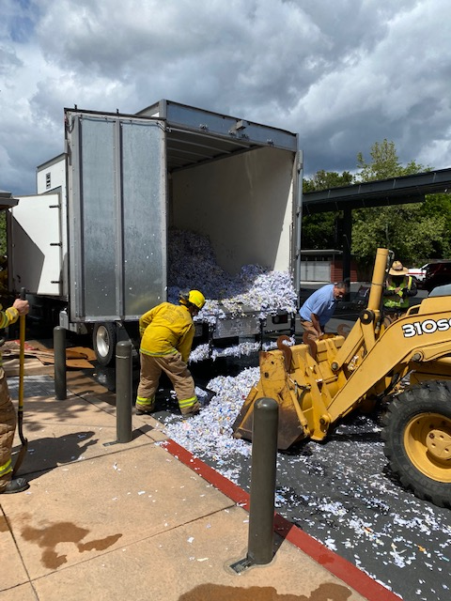


Quarter in Photos
Paper shredding truck fire

Slide 6
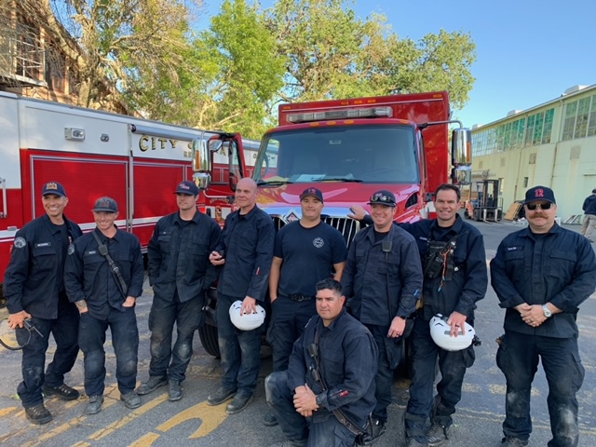
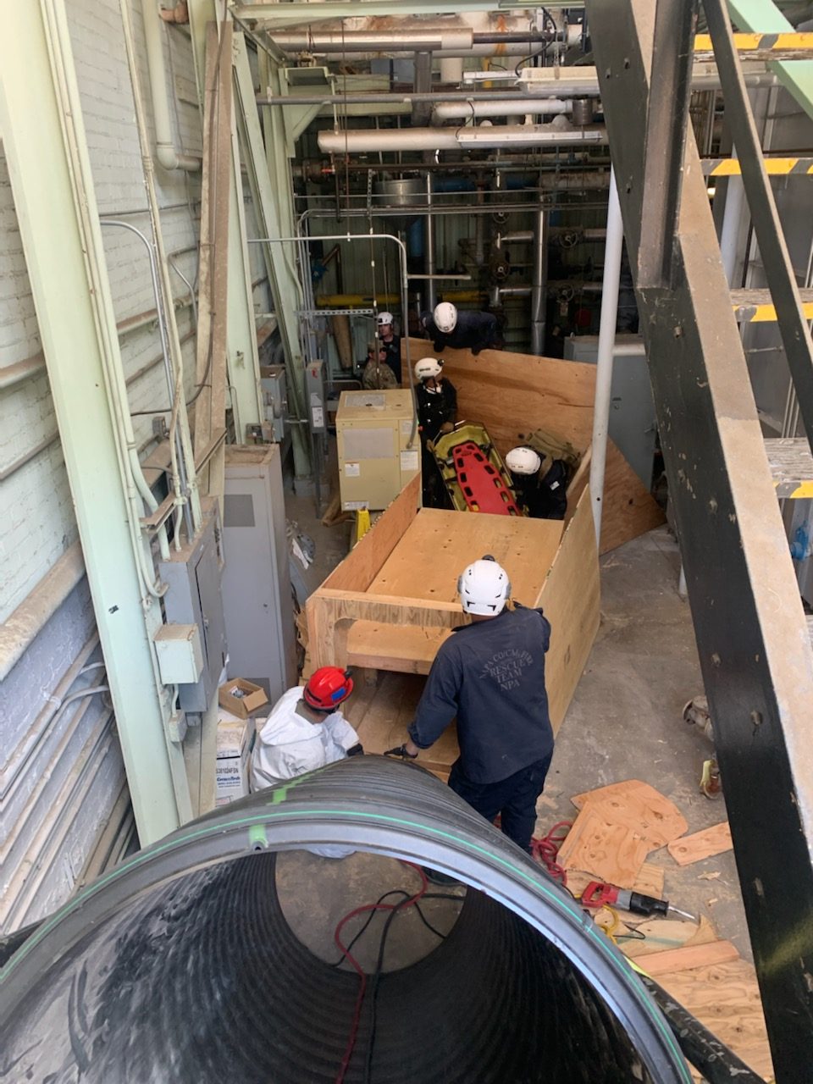
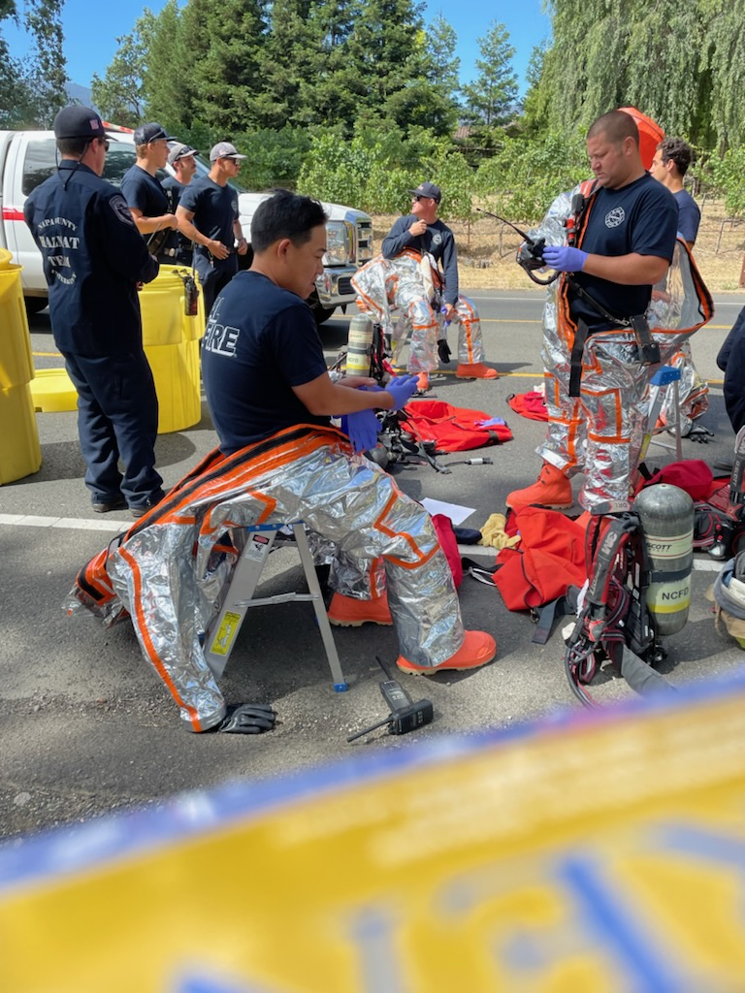
Quarter in Photos
Interagency training

Slide 7
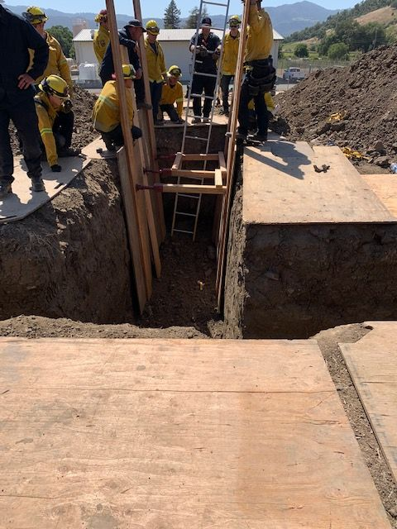
Quarter in Photos
Trench rescue technician class

Slide 8
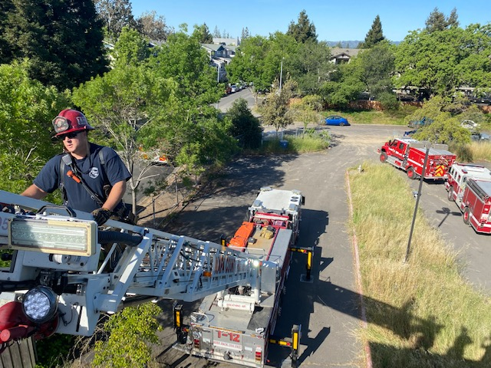
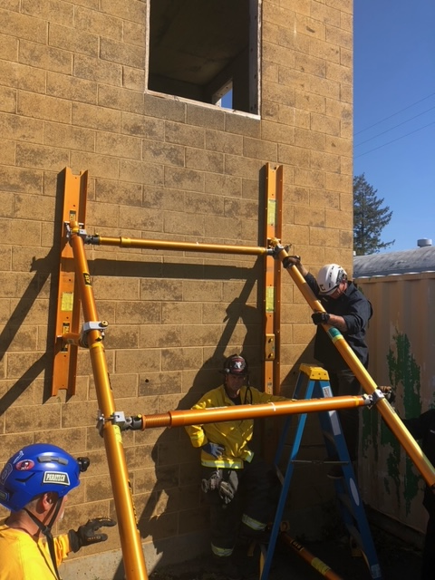
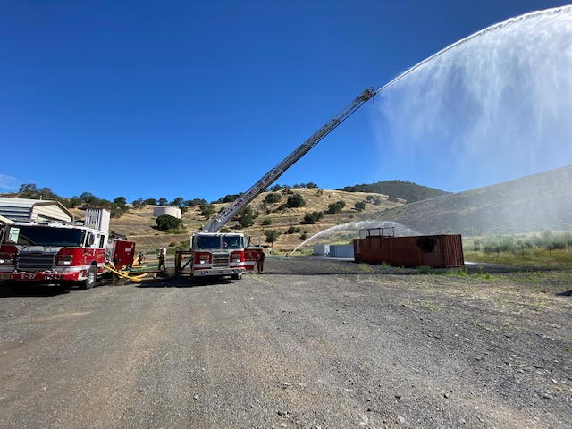
Quarter in Photos
training

Slide 9
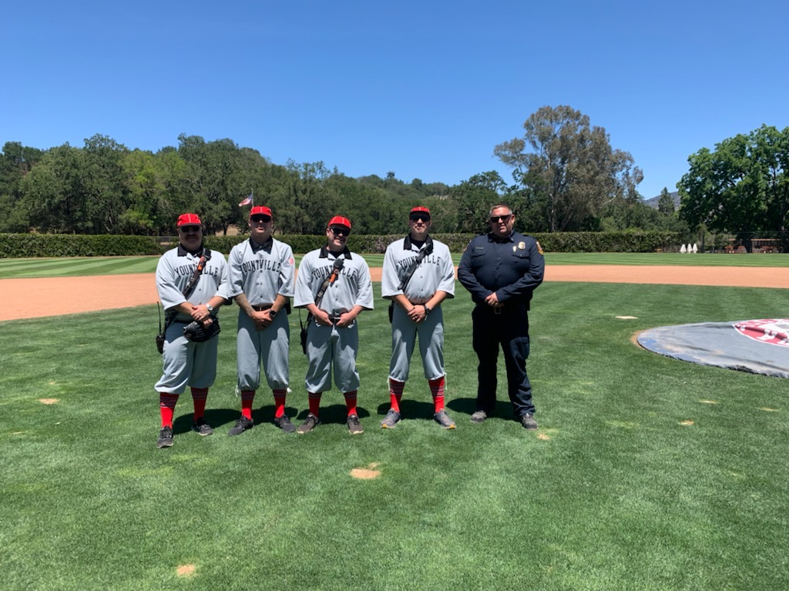
Quarter in Photos
Baseball at the veterans home

