Slide 1


Town Of Yountville
Quarterly report July August September 2022
Prepared By Engineer Kyle Black

Slide 2
Town Of Yountville
Quarterly Report 3rd Quarter 2022

Slide 5


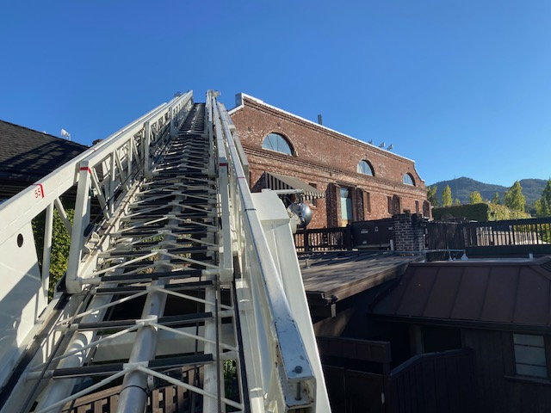



Quarter in Photos
Smoke in the ac unit at bottega

Slide 6
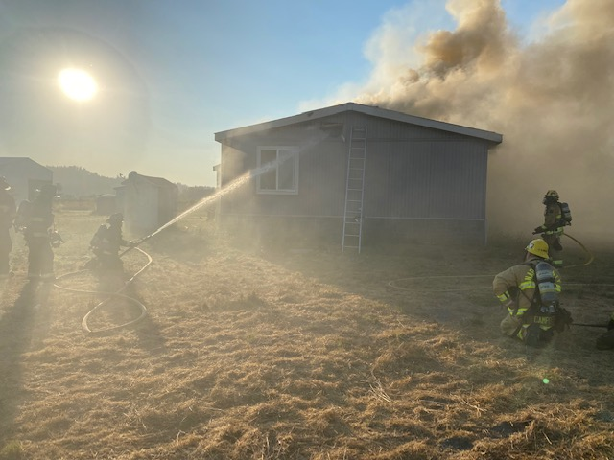
Quarter in Photos
Fire in Calistoga

Slide 7
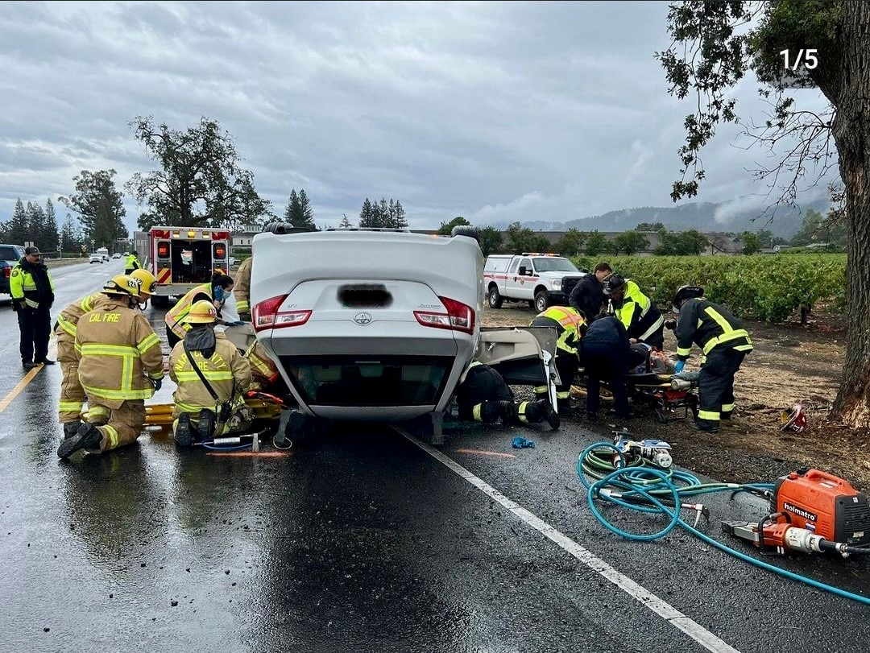
Quarter in Photos
Traffic collision

Slide 8
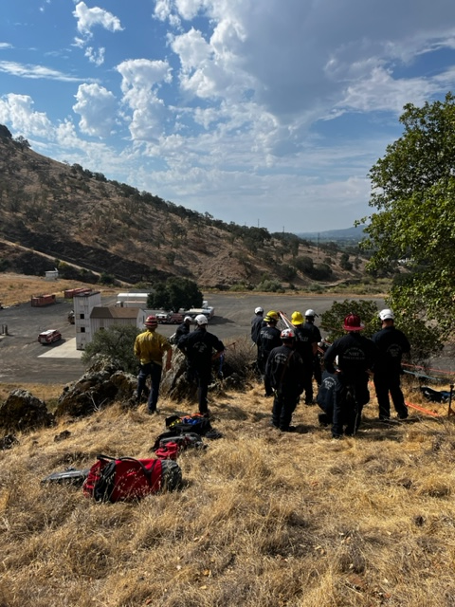
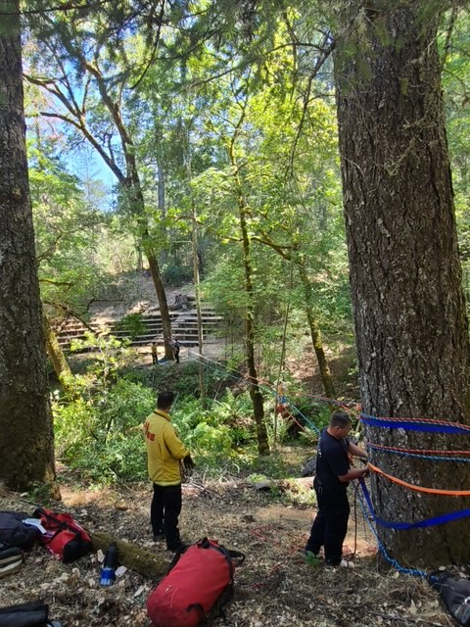
Quarter in Photos
Technical rescue training

Slide 9
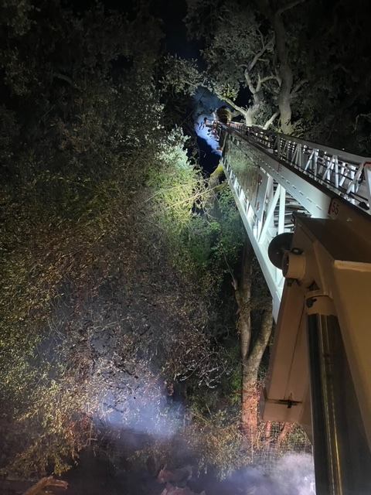
Quarter in Photos
T12 assisting ncfd st 25 with a vegetation fire

