Slide 1
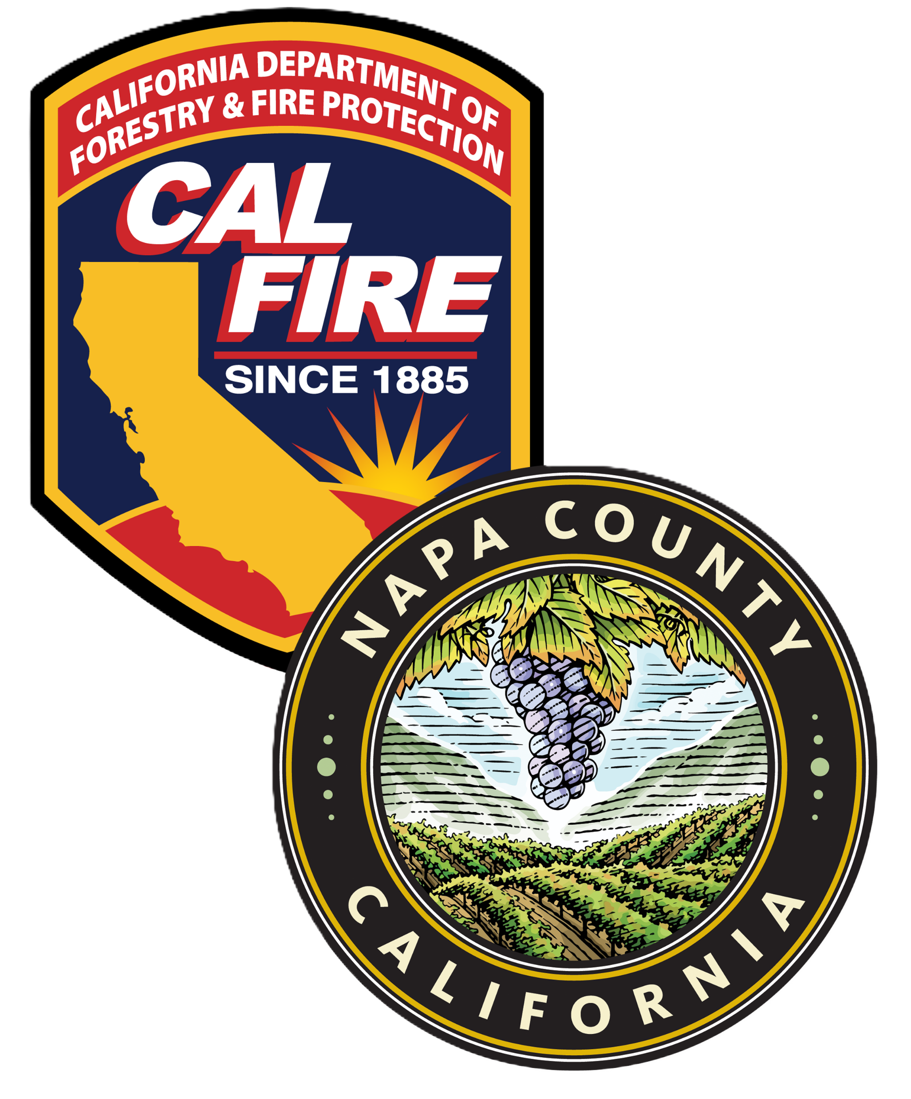
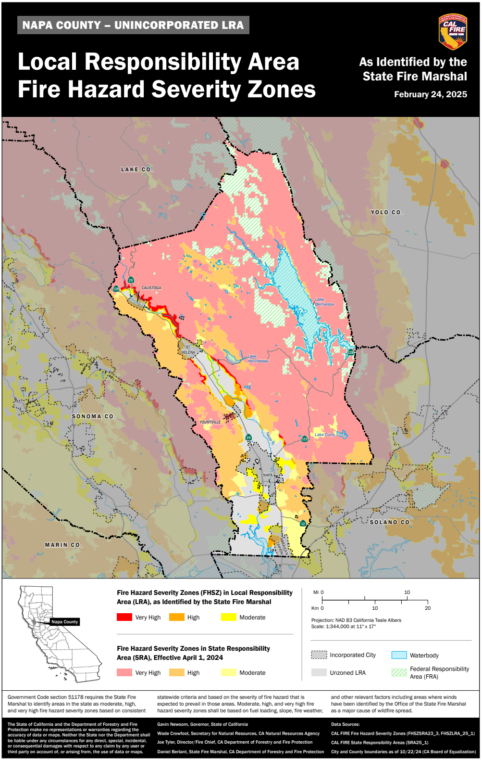

Napa County Fire Department
Local Responsibility Area
Fire Hazard Severity Zones
Local Ordinance & Map Adoption
Town of Yountville
June 3rd, 2025

Slide 2
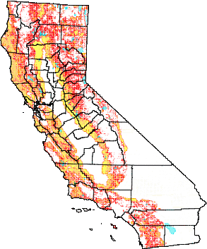
Fire Hazard Severity Zones - Facts
The maps are required by Government Code 51178 & 51179
Identify levels of fire hazard (Not Risk)
3 levels (Moderate, High, & Very High)
What are the Zones?
The maps are required by
Government Code 51178 & 51179
Identify levels of fire hazard
• 3 levels (Moderate, High, & Very High)
CAL FIRE used the best available science and data to develop, and field test a model that served as the basis of zone assignments. The model evaluated the probability of the area burning and potential fire behavior in the area.
Factors: fire history, vegetation, flame length, blowing embers, proximity to wildland, terrain, and weather

Slide 3
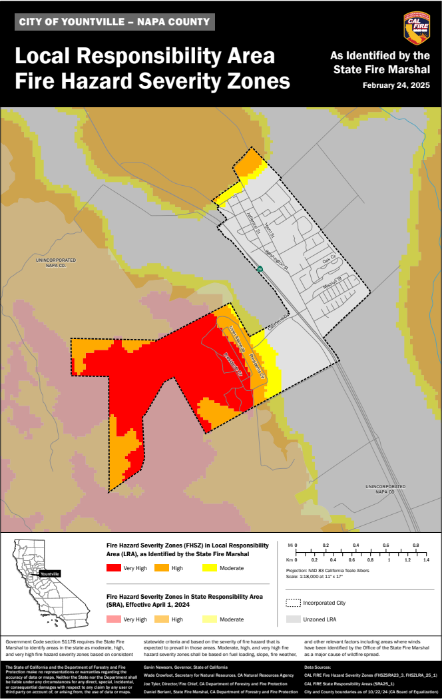
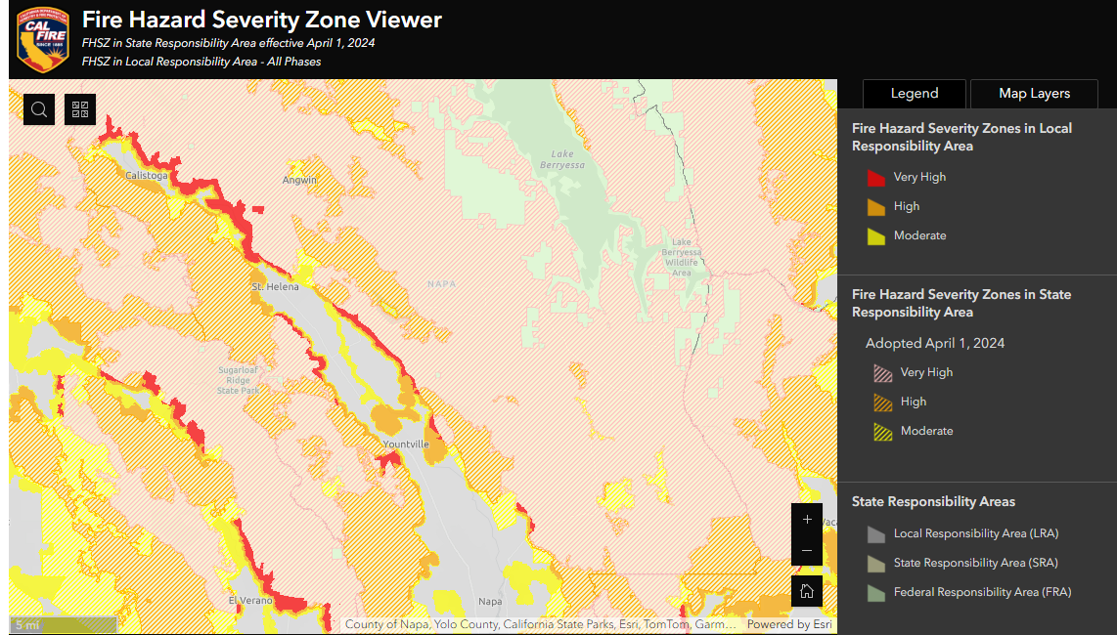
Napa County / Town of Yountville LRA Maps

Slide 4

How will these maps be used by Napa County?
Building standards for new construction in the Wildland-Urban Interface (California Building Code Chapter 7A)
Property development standards such as road widths, water supply and signage (Fire Safe Regulations)
Defensible Space Requirements (Government Code 51182)
Natural hazard real estate disclosure (AB 38 Inspections)

Slide 5
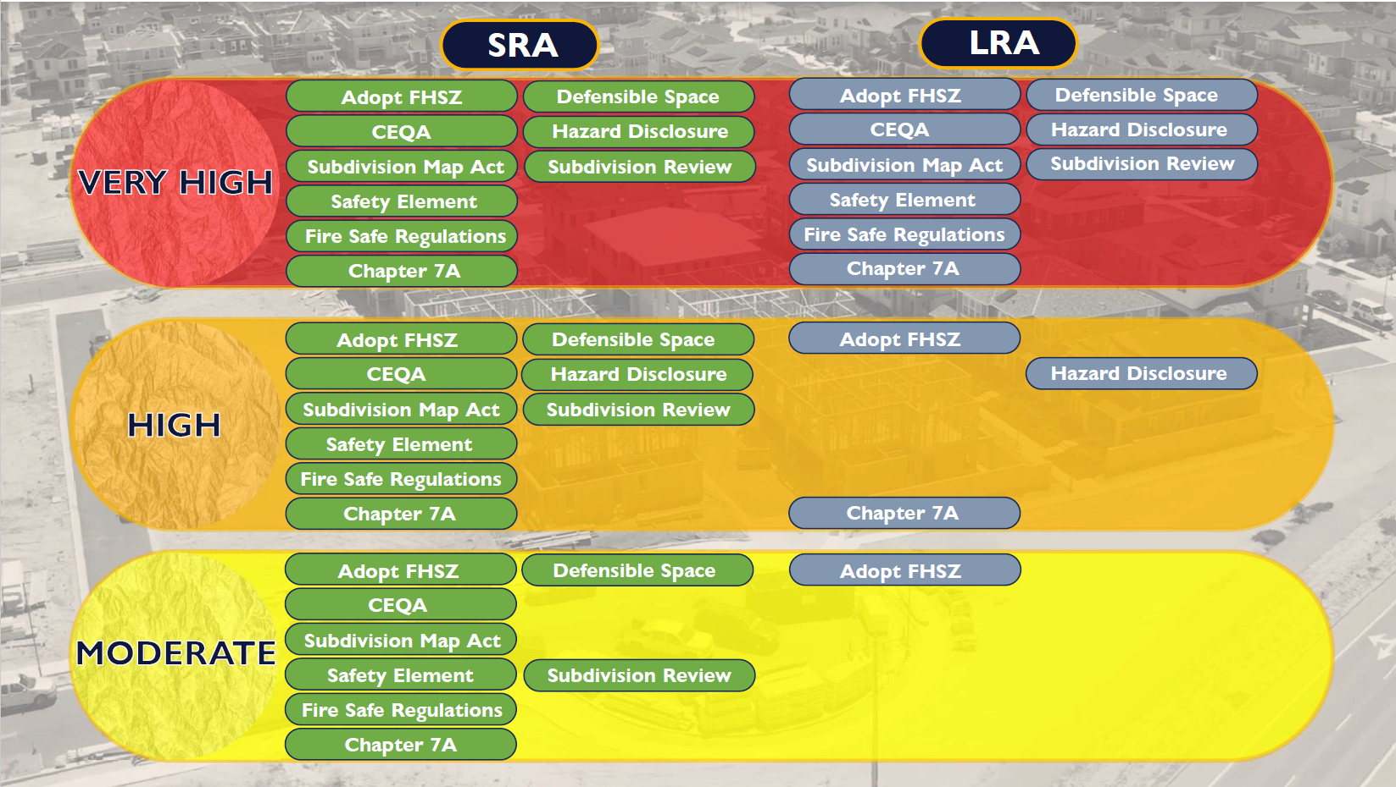
What's Impacted…..

Slide 6
How will this impact Yountville…..
Portions of northern Yountville have been designated as Moderate and High Fire Hazard Severity Zones
The Veterans Home is now classified within a Very High Fire Hazard Severity Zone (VHFHSZ).
The Office of the State Fire Marshal (OSFM) is responsible for defensible space inspections and enforcement at the Veterans Home.
CAL FIRE, Napa County Fire, NCFMO, and Firewise have completed fuel reduction projects on and west of the Veterans Home.
Additional fuel reduction projects are planned in the western hills to help protect the Veterans Home and the Town of Yountville.

Slide 7
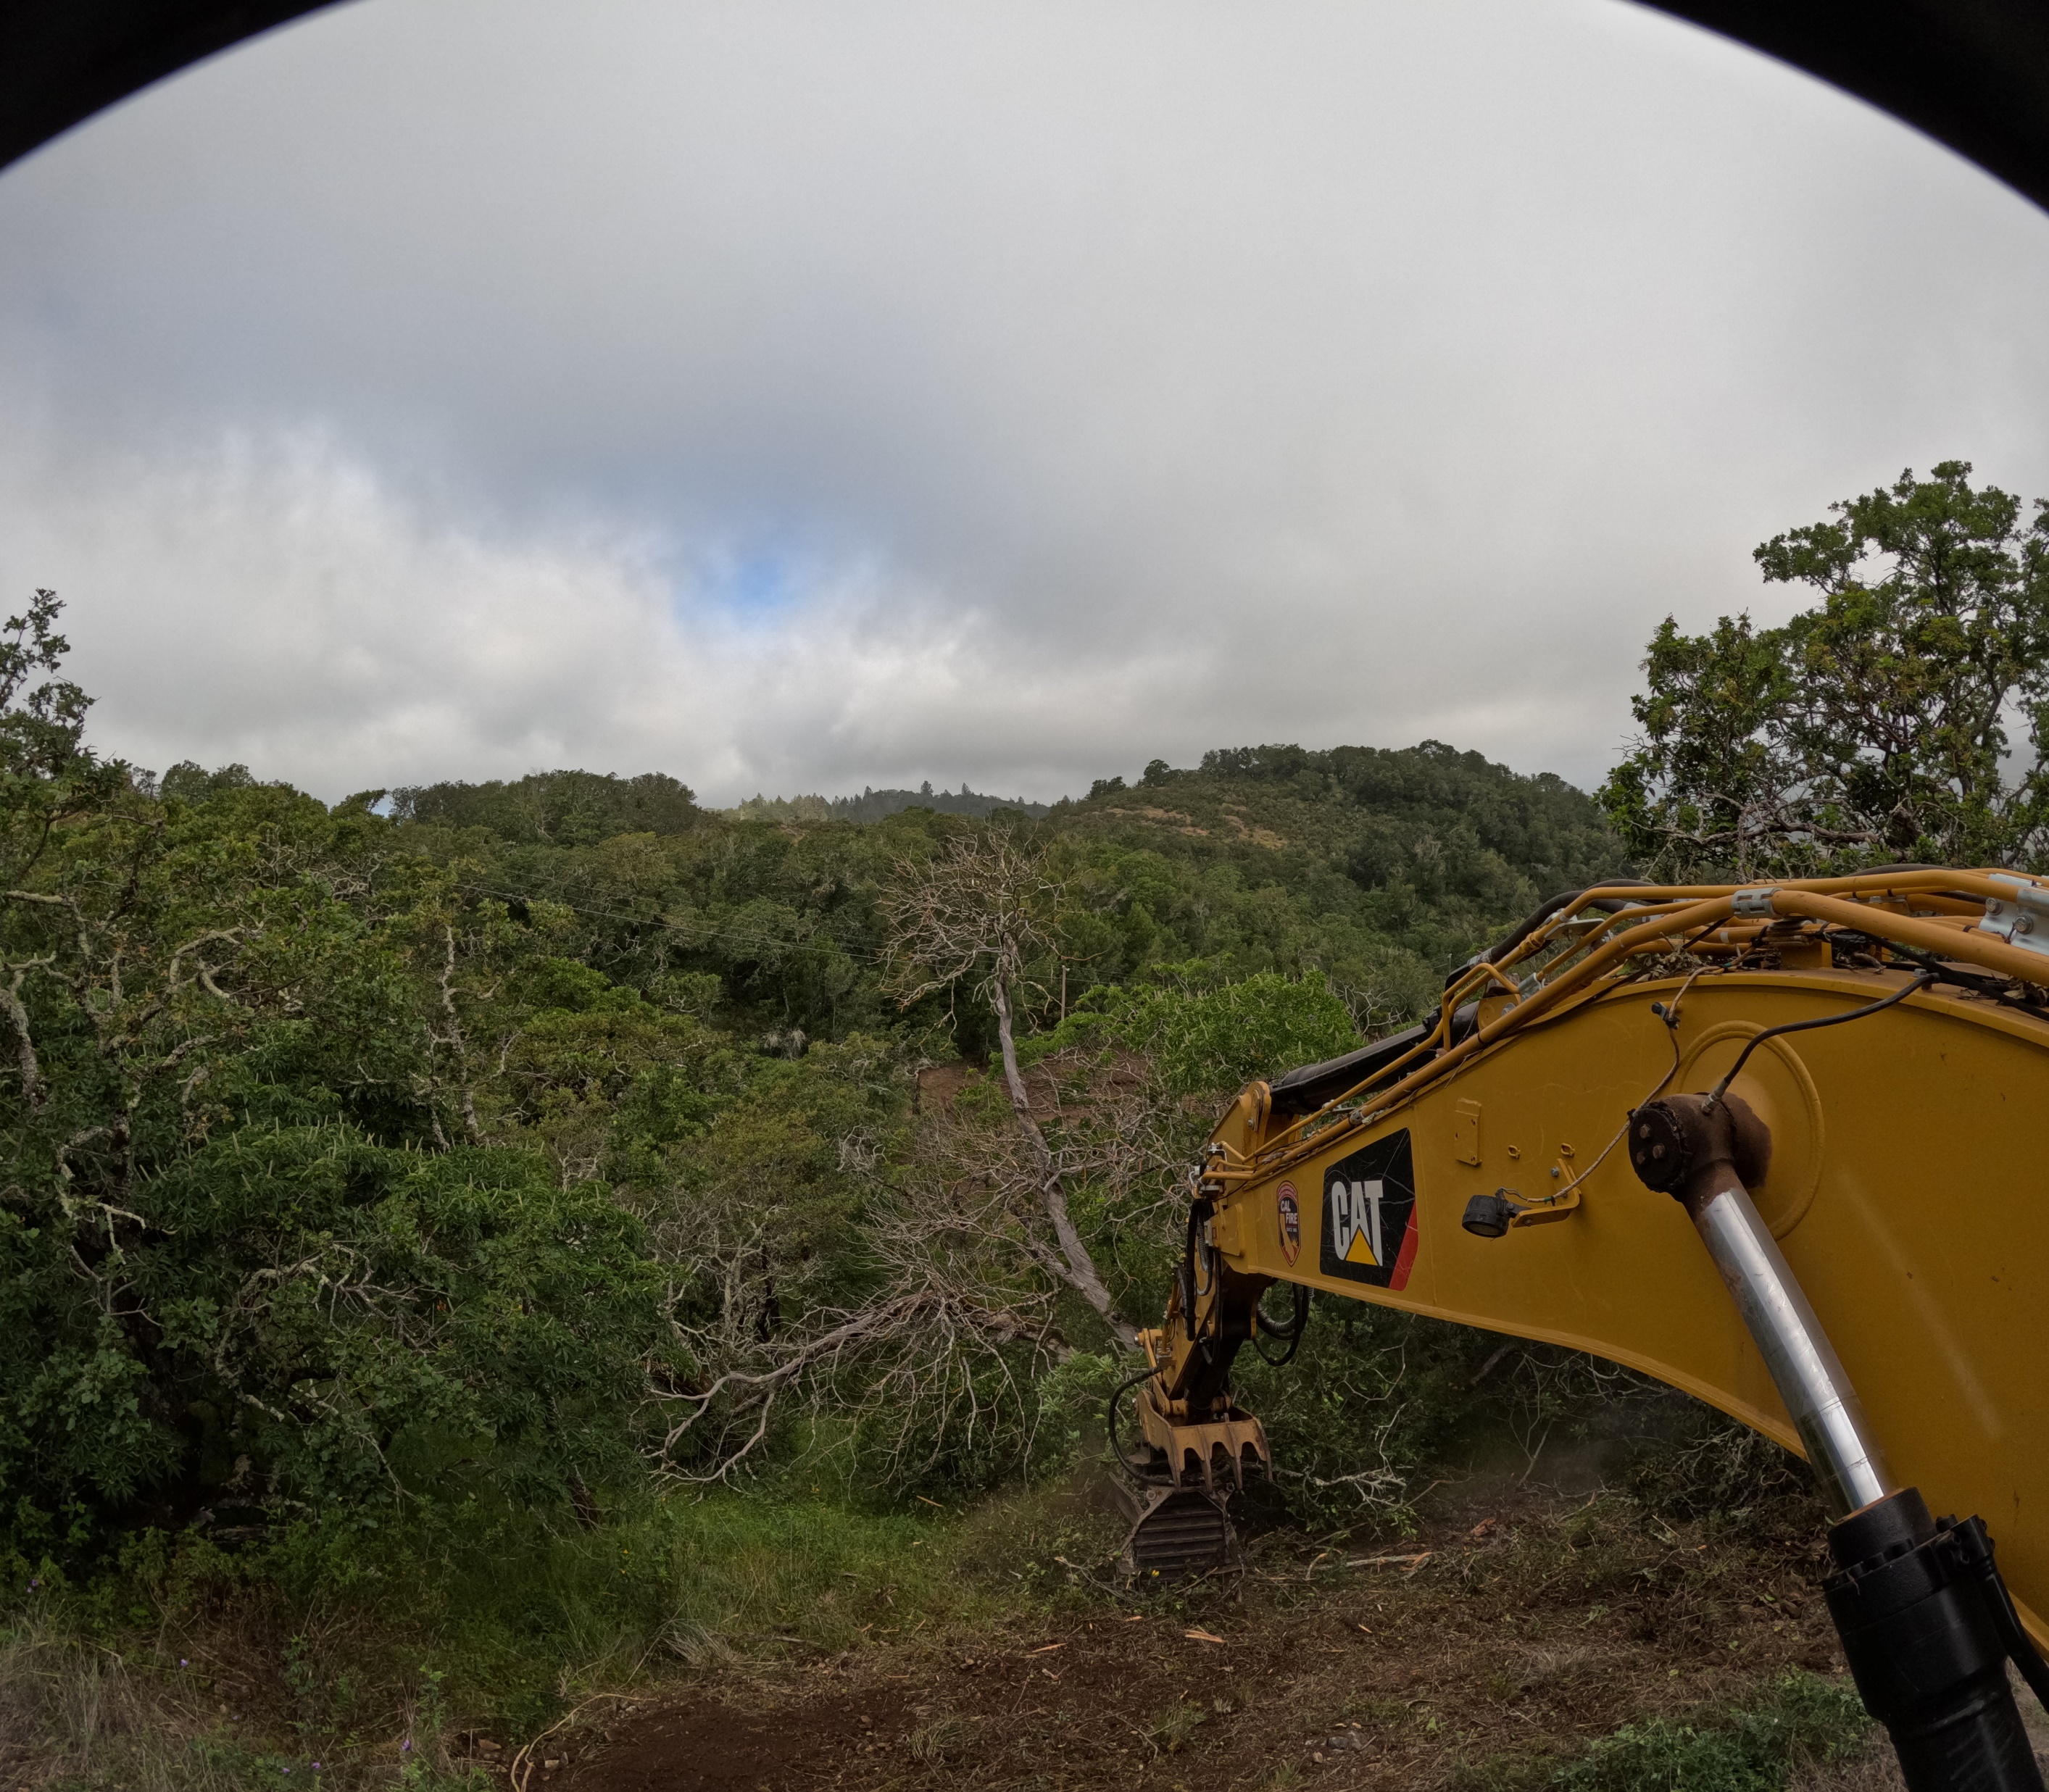
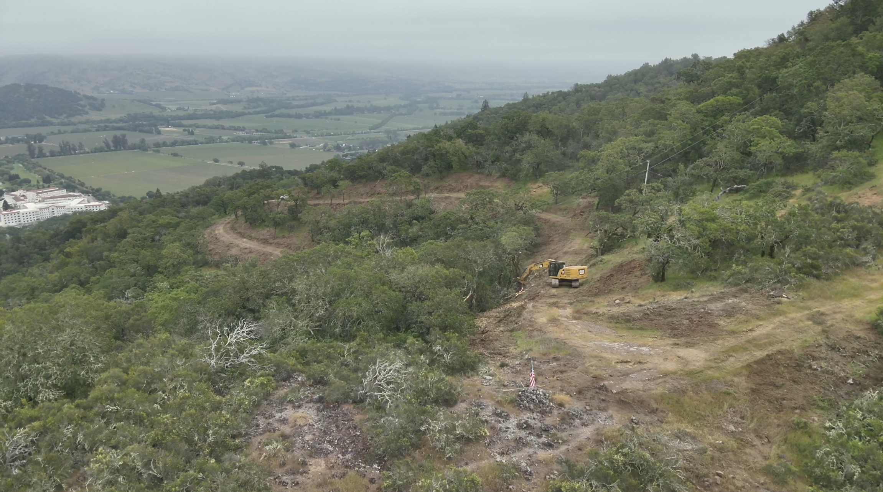
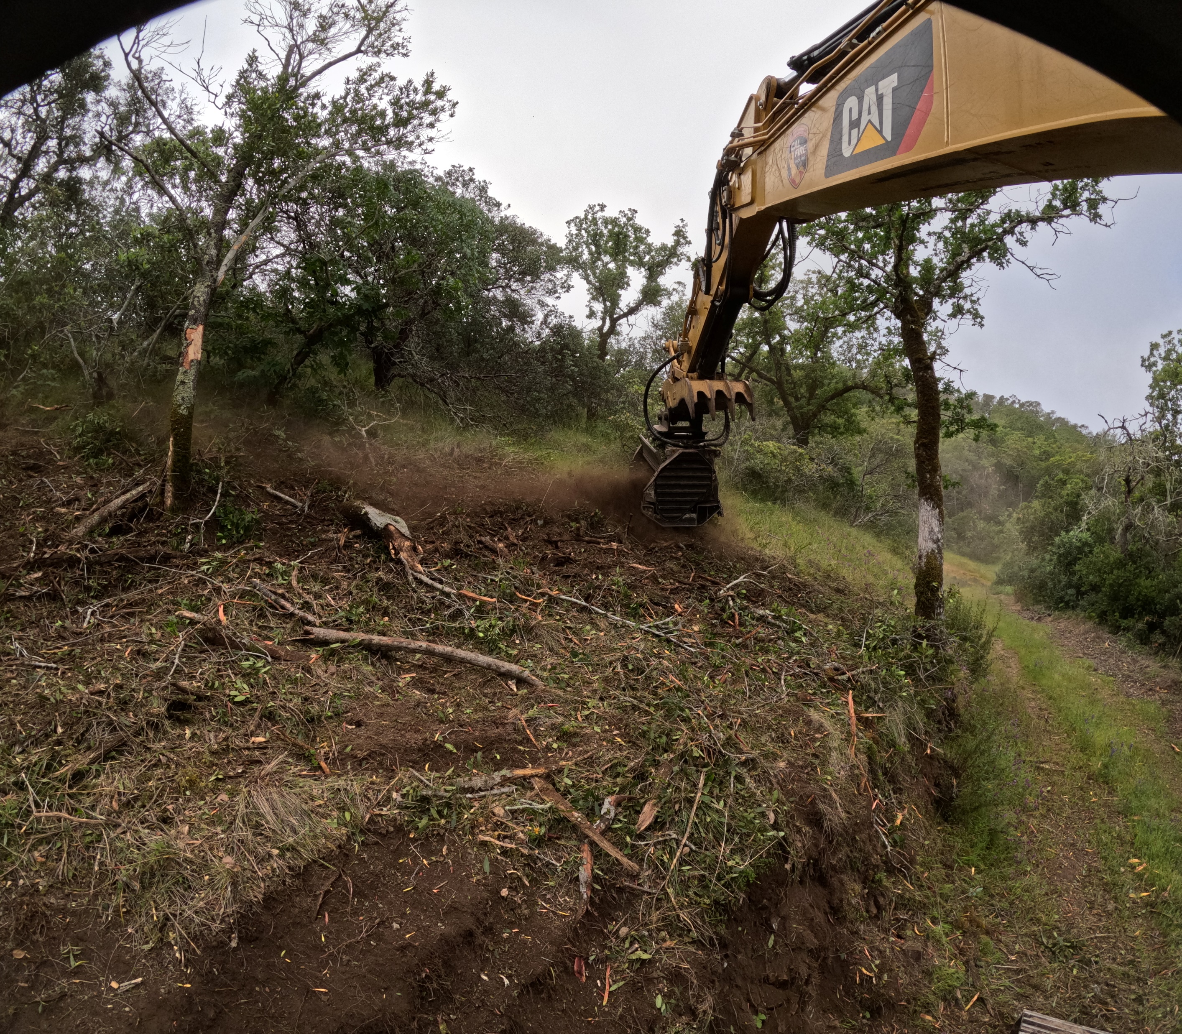
Fuel Reduction Projects…..

