Slide 1
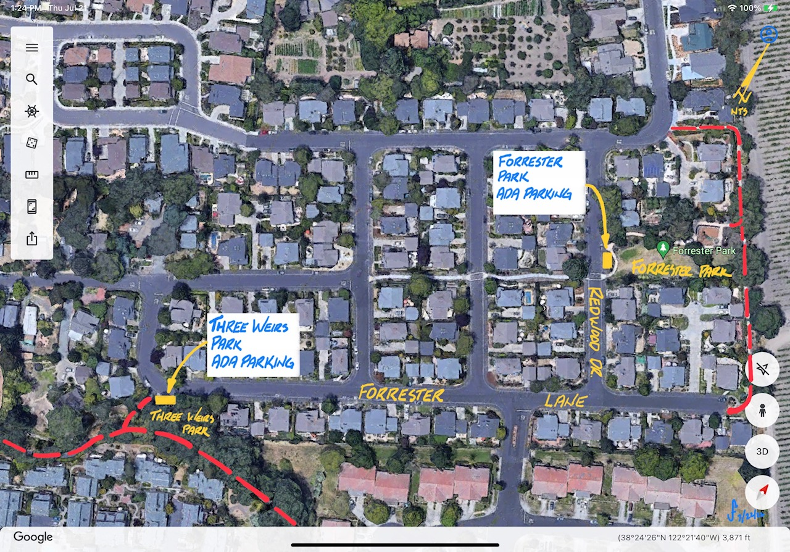
Community Outreach Meeting
July 26, 2022
5:30-6:30
ADA Accessibility Parking Forrester Park and Three Weirs Park

Slide 2
Project summary
CIP Project:
SP-0018
FY 2022/23
Grants:
Transportation Development Act (TDA) Funds
$160,000
Remaining Work
Community Outreach, Complete Design, Construction
Scope
One accessible parking stall at each location
Three Weirs Park
Forrester Park
This is NOT a project to construct sidewalks along the streets in the neighborhood.

Slide 3
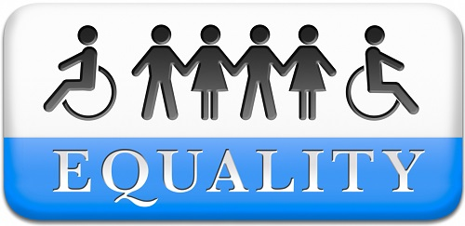
Project need
American with Disabilities Act (ADA)
Comprehensive civil rights law for persons with disabilities
Clear and comprehensive national mandate for the elimination of discrimination against individuals with disabilities.
Assures equality of opportunity, full participation, independent living, and economic self-sufficiency for all people.

Slide 4
Project need
Connectivity
Town Parks & Path Map
Destinations include:
Three Weirs Park
Forrester Park

Slide 5
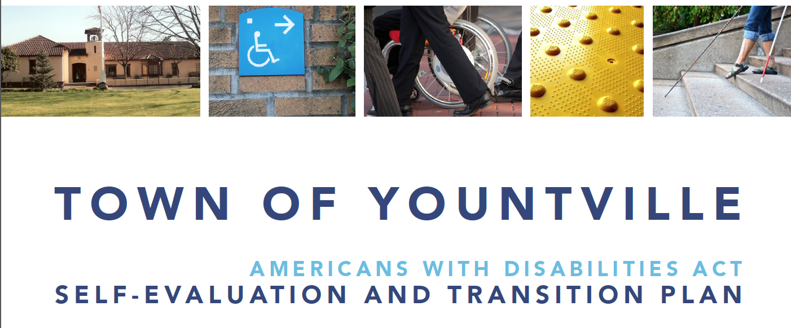
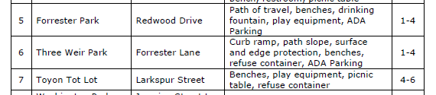
Project need
Town Compliance
2015 ADA Evaluation
Projects in Years 1 thru 4
Now in Year 7

Slide 6
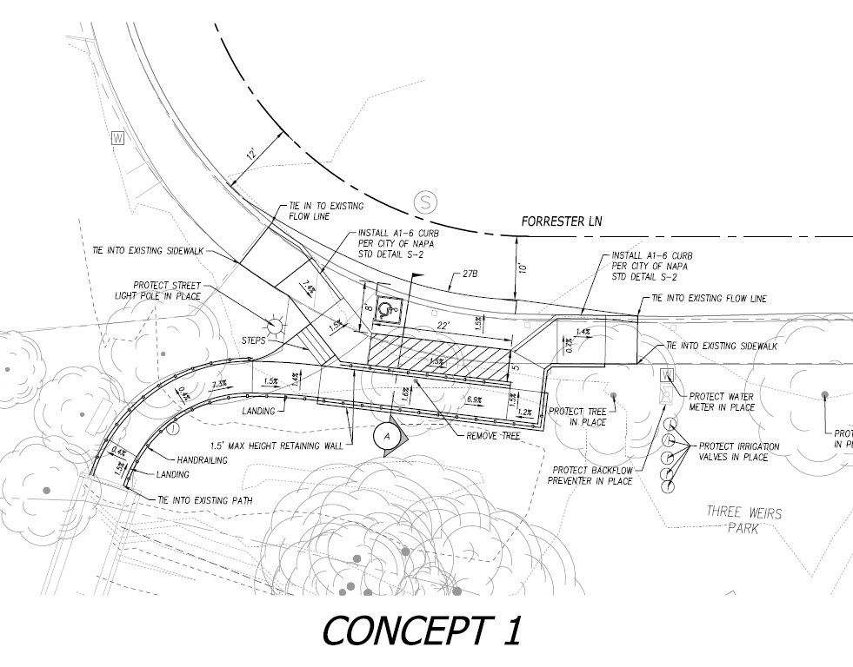
Three weirs park

Slide 7
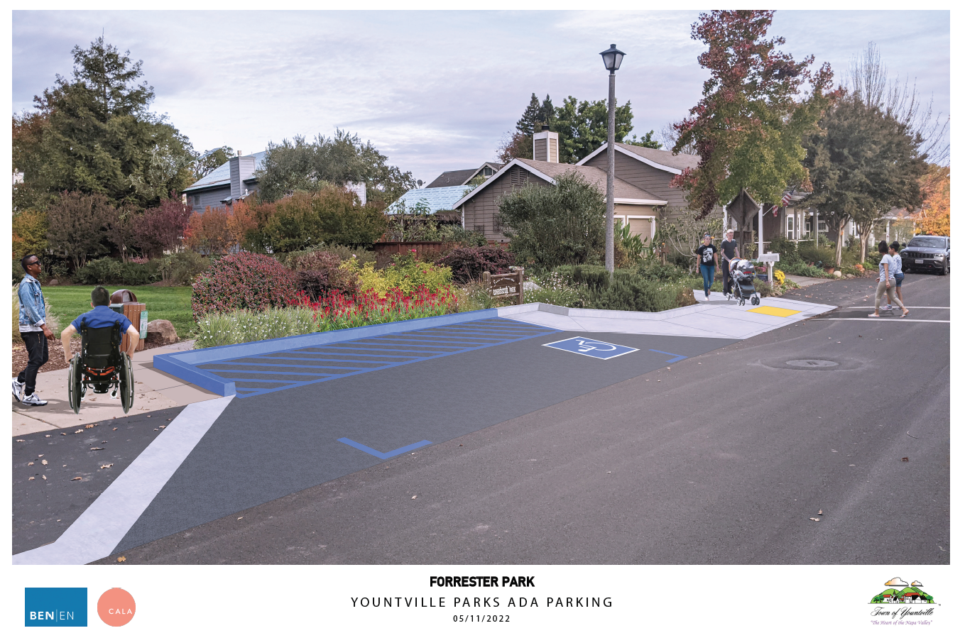
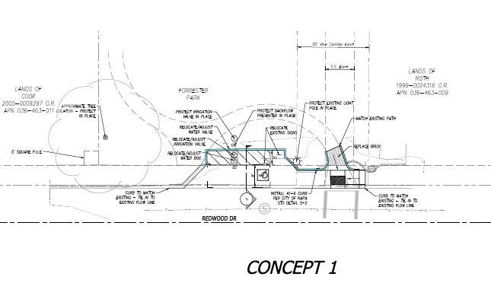
Forrester park

Slide 8
COMMENTS OR QUESTIONS?
Contact:
email: rramirez@yville.com
phone: (707) 944-8851
Rosalba Ramirez

Slide 10
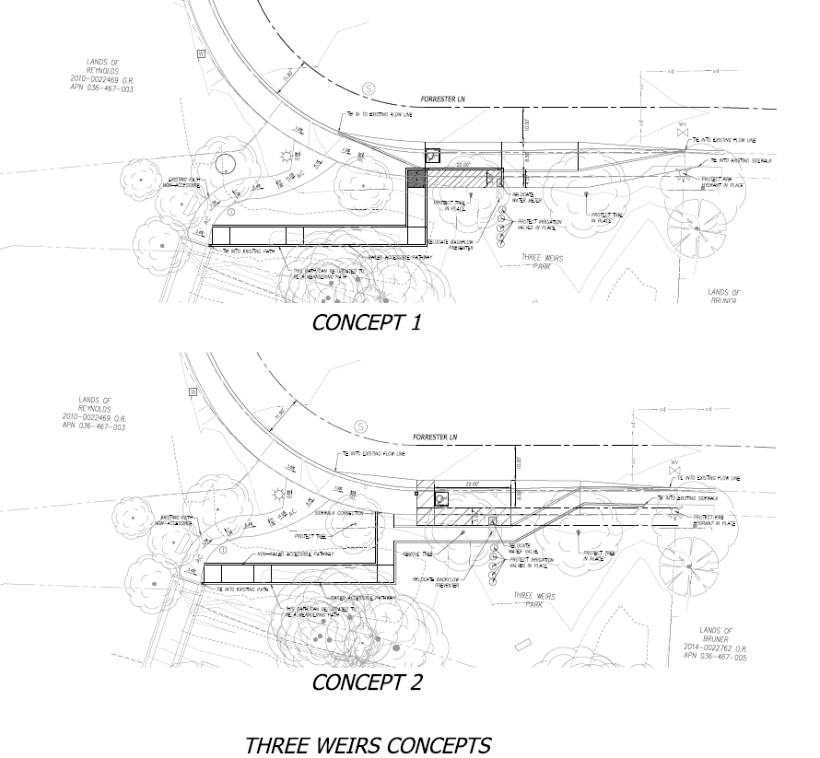
Alternates three weirs

